Slide 1
Designing interactions between Tangibles
Presented by Faroukh Davouzov

Slide 2
What are tangibles?
In context of Human-Computer Interaction
Physical objects to manipulate digital information
Ex: Physical Globe to manipulate world map information

Slide 3
Goal
Focus not only digital information but also collaboration
To design interactions between tangibles

Slide 4
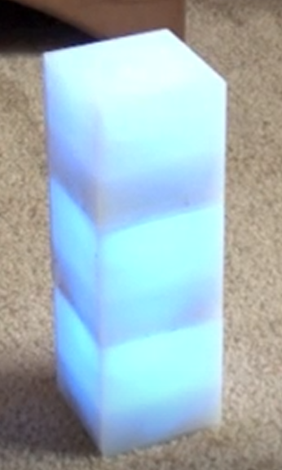
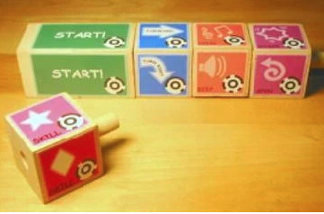
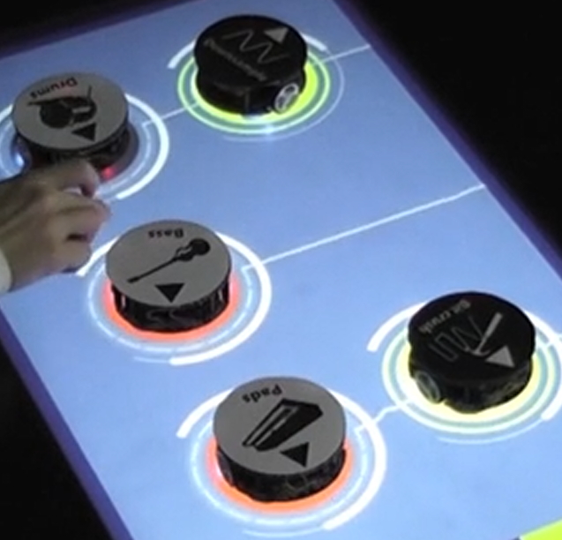
Related work
Games, where tangibles would plug in to the other
Tern tangible programming
Time blocks
Tangible bots
Term tangible programming
Time blocks
Tangible bots

Slide 5
TangoJudo Interface
Learn the katas from judo via tangibles

Slide 6
TangoJudo Interface: Interactions
Tangibles know each others positions
Can indicate which ones to be switched
Once ordered, video will play kata in order
Tangibles know each others orientation

Slide 7
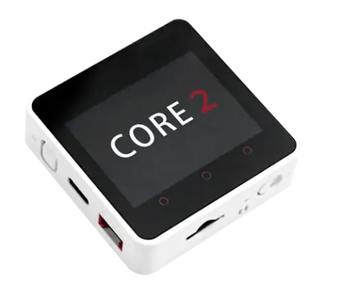
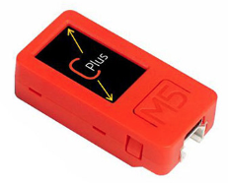
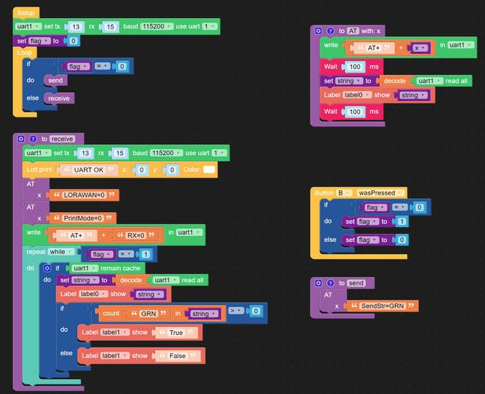
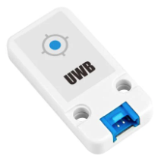
TangoJudo Interface: Implementation
4 pieces - M5Stack Core2
3 pieces – M5StickC
7 pieces – UWB Sensor
UIFlow (Software)

Slide 8
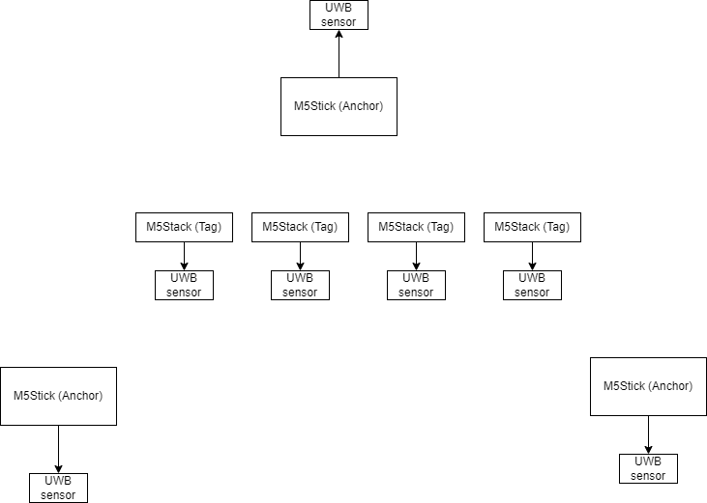
TangoJudo Interface: Implementation

Slide 9
Challenges
UIFlow vs UIFlow2 vs Arduino
Bluetooth or Wifi?

Slide 10
Future Plans
Research
Implementation

